Slide 1

Cricket Batsman Strike Rate
V.SHIVA CHAITHANYA -2203A52060

Slide 2
INTRODUCTION:
There are various parametres that we need to take into consideration in
order to calculate.
we have choosen linear regression to predict batsman strike rate
according to the matches,runs,average and economy.
Because in linear regression string values cannot be find.
In our dataset we are going to explain the features of bastman with
strike rate.
A measure of the relation between the mean value of one variable (output) and corresponding,
Values of other variables is called regression.

Slide 3
Definition – What is “Batting Strike Rate” in Cricket?
Batting Strike Rate (BSR) is a measurement of how frequently the batsman scores runs.
It is a measurement of runs scored per 100 overs faced.
A batsman with a high strike rate is considered to score more runs each time they are at bat.
Strike rate is a more important statistic in shorter games or games with limited overs.

Slide 4
Formula – How to calculate BSR
Batting Strike Rate = (Runs Scored x 100) ÷ Balls Faced
Where:
“Runs Scored” is the number of runs scored by the batsman.
“Balls Faced” is the number of balls faced by the batsman.

Slide 5
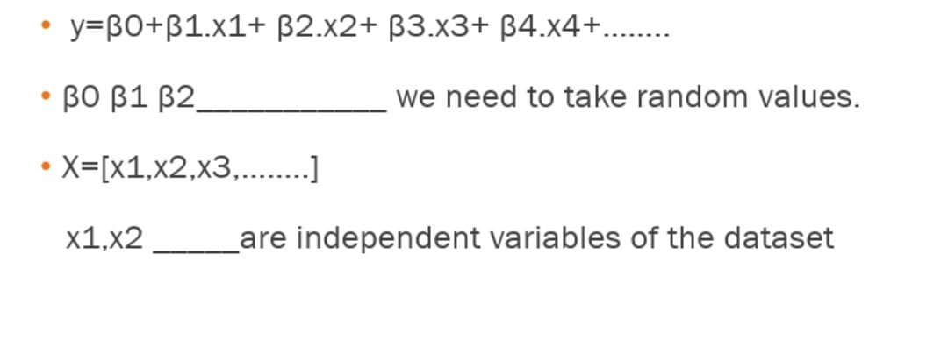
LINEAR REGRESSION MODEL

Slide 6
This dataset provides a name of the team,players along with matches,runs,highest and average of a batsman

Slide 7
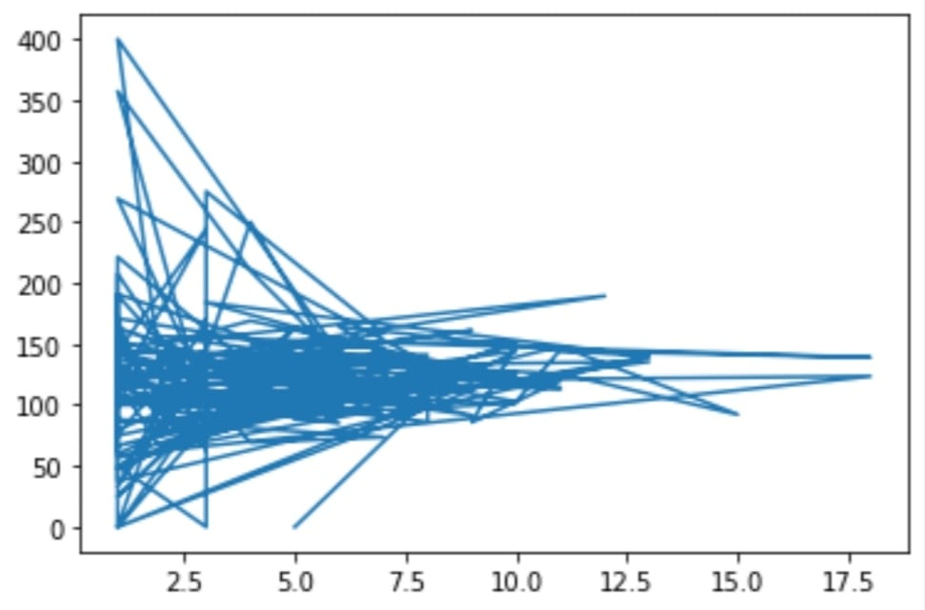
x1=d[‘Matches’] y=d[‘Strike_rate’]
[<matplotlib.lines.Line2D at 0x7fce06b9e810

Slide 8
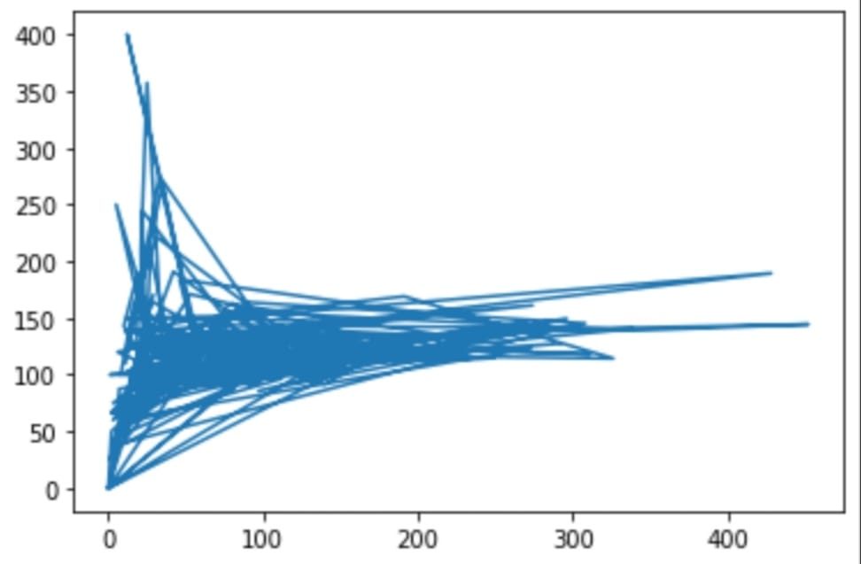
x2=[‘Runs’]
[<matplotlib.lines.Line2D at 0x7fce06b9e810

Slide 9
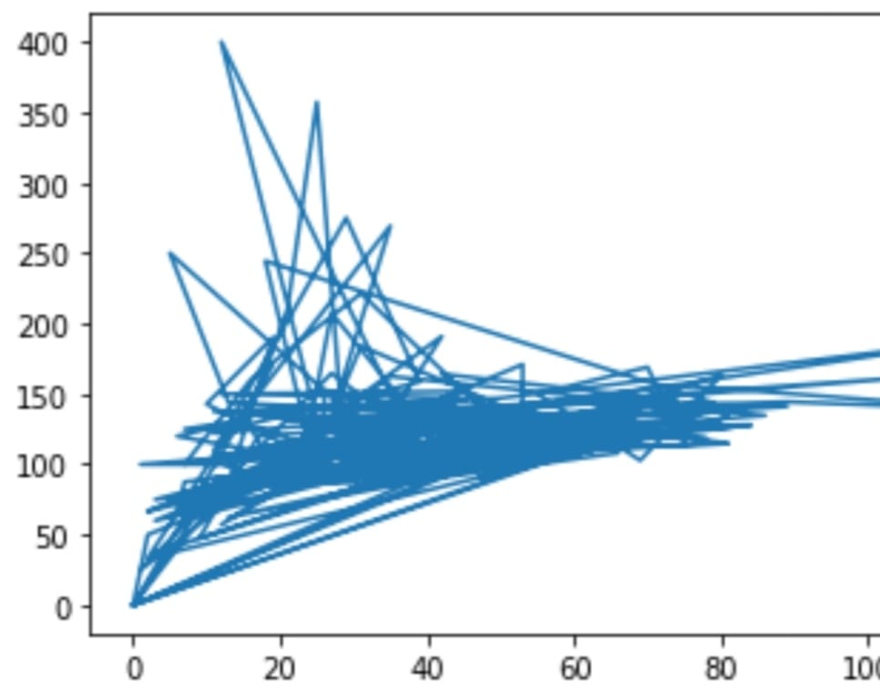
x3=[‘Highest’]
[<matplotlib.lines.Line2D at 0x7fce06b9e810

Slide 10
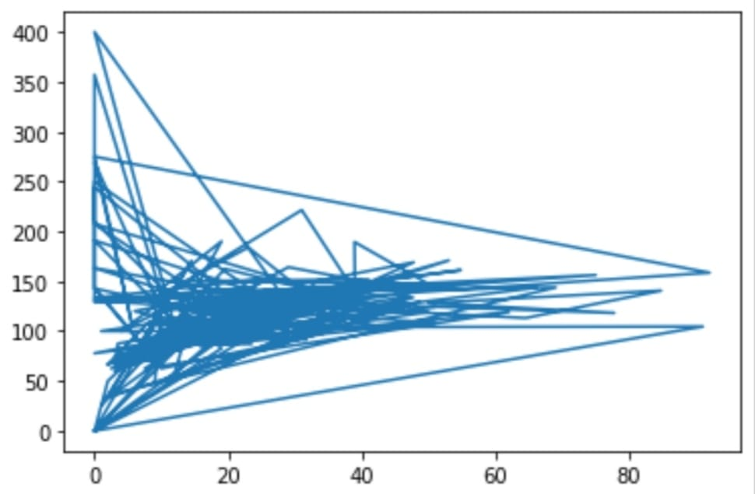
x4=[‘Average’]
[<matplotlib.lines.Line2D at 0x7fce06b9e810

Slide 11
ATTRIBUTES LIST:
(Team)Name of the team.
Name of the player in a team.
Runs scored from different team.
Number of matches player played.
Number of runs scored in a match.
Highest runs scored by a player from all matches.
Average of the batsman who played matches.
Strike rate of the batsman depends on the runs he scored in a match.
Batting Strike Rate = (Runs Scored x 100) ÷ Balls Faced

Slide 12
APPROACH:
The approach we used in the batsman strike rate on data set is regression.
REGRESSION consists of mathematical methods that allow data scientists to predict a continuous outcome(y) based on the value of predictor variable(x).
In the above data set all the 7 attributes are considered as INDEPENDENT VARIABLES (x) and Strike Rate as DEPENDENT VARIABLE (Y).
The linear equation used to find prediction values is:
ȳ=BX1+BX2+……………..BX14+BX15..

Slide 13
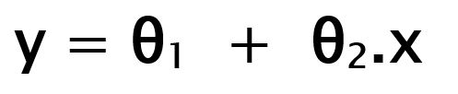
Linear Regression
Linear Regression is a machine learning algorithm based on supervised learning. It performs a regression task. Regression models a target prediction value based on independent variables.
It is mostly used for finding out the relationship between variables and forecasting. Different regression models differ based on – the kind of relationship between dependent and independent variables they are considering, and the number of independent variables getting used.
There are many names for a regression’s dependent variable. It may be called an outcome variable, criterion variable, endogenous variable, or regressand.
The independent variables can be called exogenous variables, predictor variables, or regressors.

Slide 14
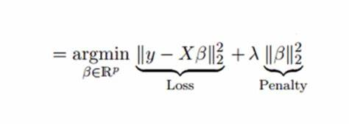
Ridge Regression
Ridge regression is a model tuning method that is used to analyse any data that suffers from multi collinearity. This method performs L2 regularization.
Ridge regression is a technique which is used for analyzing multiple regression where the data suffers from multi collinearity.
The problem which arises due to multi collinearity is that the basic linear regression model (least square estimates) becomes unbiased and the variance becomes so large that the predicted values are far from the true value.
The advantage of using the ridge regression is to avoid over fitting. It works in the same way as the linear regression but it just adds an extra term (α) which helps in the reduction of overfitting.
It method used for the analysis of multicollinearity in multiple regression data.

Slide 15

Lasso Regression
Lasso regression is a type of linear regression that uses shrinkage.
It is a statistical formula for the regularization of data models and feature selection. Shrinkage is where data values are shrunk towards a central point, like the mean. The lasso procedure encourages simple, sparse models (i.e. models with fewer parameters).
lasso regression follows greedy regression and it is automatically select the feauters than ridge regression.
This particular type of regression is well-suited for models showing high levels of muti collinearity or when you want to automate certain parts of model selection, like variable selection/parameter elimination.

Slide 16
CONCLUSION
This dataset comes under parametric method.
In parametric method it comes under supervised machine learning.
In this data set y values are quantitative data.
So,it is Regression.
We use linear regression and mean square error method instead of KNN because in KNN dimensions(x) increases distance or calculation also increases .so,the performance decreases.
That is why we use linear regression.
https://github.com/Shiva-vangala/Stat-ml.git

Slide 17
THANK YOU

